Slide 1

cv
Emotion Detection Using AI in Restaurants
Team Members
1. Anish Singhal
2. Rishi Raj
3. Samhitha P Rao
4. Sarthak Sahu
Under the Guidance of
Nidhishree M S
Assistant Professor, Department of Computer Science and Engineering
Department of Computer Science & Engineering, DSCE

Slide 2
cv
INDEX :
Introduction
Literature Review
Base Paper Analysis
Project Description
Challenges in current work
Conclusions
References
Department of Computer Science & Engineering, DSCE

Slide 3
cv
INTRODUCTION
Our Emotion AI project aims to utilize facial emotion detection models to perceive and measure the subtle emotional states experienced by patrons in dining establishments, providing a comprehensive evaluation of the overall restaurant experience, including the quality of food and the efficiency of service, notably in terms of waiting times.
Such a system will enable restaurant owners to gain an unparalleled understanding of customer feelings and satisfaction levels, thereby facilitating data-driven decisions aimed at improving the overall dining experience.
This project represents a pioneering step towards leveraging advanced AI technology to create a more responsive and customer-centric restaurant industry
Department of Computer Science & Engineering, DSCE

Slide 4
cv
Literature Review
S.No | Authors | Proposed Method & Technique used | Advantages | Disadvantages
1 | Chen, Xufeng [1] | CPAC questionnaire (Cognitive Processes Associated with Creativity) IBM SPSS Statistics | High Efficiency in Both Approaches Cognitive Improvement Diverse Levels of Completion | Standard Deviation Complexity of Interaction Studies Learner Anonymity not guaranteed
2 | Amir Goli [2] | Assessment Sheets Likert Scale Data Analysis | Student-Centered Learning Multi-Modal Interface Real-Time Feedback | Need for Long-Term Study Small Sample Size Further Development Needed
3 | Fahima Djelil and Eric Sanchez [3] | Didactic Transposition Analysis Objects-First Approach Metaphorization and Ludicisation Processes Analogical Relations Analysis Conjecture Mapping | Metaphor-Based Learning Debriefing Process Engagement through Play | Metaphorical Limitations Debriefing Complexity Research Gaps
Department of Computer Science & Engineering, DSCE

Slide 5
cv
Literature Review
S.No | Authors | Proposed Method & Technique used | Advantages | Disadvantages
4 | Manzoor Ahmed Khan [4] | ARCS Design Model (Attention Relevance Confidence Satisfaction) ADDIE (Analysis Design Develop Implementation) | Self-Paced Learning Effectiveness Safe Learning Environment | Overemphasis on Gaming Content Quality Resource Requirements
5 | Laura Romero Rodríguez [5] | RPG Maker MV Survey : Categorical questions Numerical questions Open-text questions | Engagement and Motivation Ease of Use Adaptability Improved Acceptance | Challenge of Content Alignment Potential Overemphasis on Gaming
6 | Carlos Merino-Campos [6] | NBA 2K16 SPSS statistical software Kolmogorov-Smirnov test Levene’s test | .Unique Approach Advocating Physical Activity Improved Reasoning | Small Sample Size Preliminary Findings Limited to physical education
Department of Computer Science & Engineering, DSCE

Slide 6
cv
Base Paper Analysis
Objective of the Research:
The objective of the research is to propose a deep learning-based multimodal emotion recognition (MER) method that can adaptively integrate the most discriminating features from facial expressions, speech, and electroencephalogram (EEG) to improve the performance of the MER.
Methodology:
The proposed MER method consists of three branches: a facial branch, a speech branch, and an EEG branch. Each branch extracts features from its corresponding modality using a deep learning model. The facial branch uses an improved GhostNet neural network, the speech branch uses a lightweight fully convolutional neural network (LFCNN), and the EEG branch uses a tree-like LSTM (tLSTM) model.
The features extracted from the three branches are then fused at the decision level using a weighted averaging scheme. The weights are assigned to each branch adaptively based on the confidence scores of the individual branch predictions.
.
Department of Computer Science & Engineering, DSCE

Slide 7
cv
Base Paper Analysis
Confirmation of Hypothesis:
The multimodal emotion recognition can be improved by adaptively integrating features from facial expressions, speech, and EEG. The experimental results confirmed this hypothesis, as the proposed multimodal MER method outperformed the state-of-the-art methods that only used one or two modalities.
Statistical Analysis:
The experimental results were statistically analyzed using the paired t-test. The results showed that the proposed MER method was significantly better than the state-of-the-art methods on all three datasets.
Relevance of Findings:
The findings of this research are relevant to a wide range of applications, such as human-computer interaction, affective computing, and educational technology.
Department of Computer Science & Engineering, DSCE

Slide 8
cv
OBJECTIVES OF THE PROJECT
Develop Emotion Detection Model
Create a robust facial emotion detection model that accurately identifies and classifies a range of emotions expressed by restaurant customers, including delight, excitement, dissatisfaction, and others.
Real-Time Emotion Monitoring
Implement a real-time monitoring system within the restaurant to continuously capture and analyze customer emotions during their dining experience, leveraging live video feed or image analysis.
Menu Optimization
Utilize emotion data to optimize the restaurant's menu offerings by identifying popular dishes and understanding customer preferences, leading to menu adjustments and enhancements.
Department of Computer Science & Engineering, DSCE

Slide 9
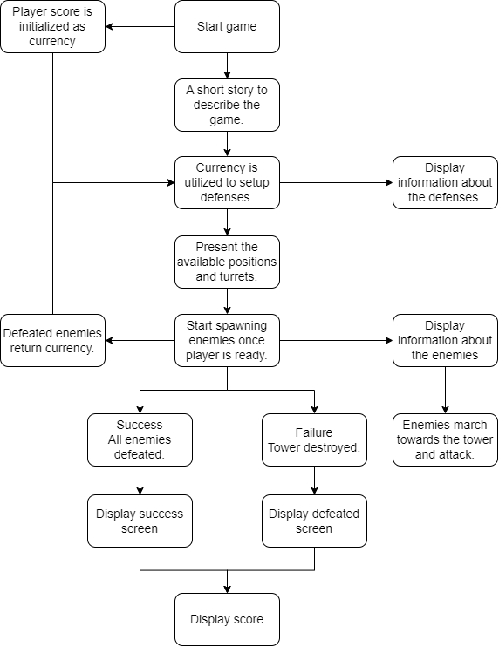
cv
System Model
Department of Computer Science & Engineering, DSCE

Slide 10
cv
CHALLENGES IN THE CURRENT WORK
1. Adapting to Customer Preferences: Customer preferences and tastes can vary widely, and staying attuned to these changes is essential for restaurant success. Emotion AI can help restaurants understand evolving customer preferences by analyzing emotional responses to different menu items and experiences, enabling them to adapt their offerings accordingly.
2. Service Efficiency: In a world where fast and efficient service is highly valued, managing wait times and service speed is a significant challenge for many restaurants. Emotion AI can assist in identifying bottlenecks and service delays, allowing restaurants to streamline their operations and reduce customer frustration.
3. Guest Experience Enhancement: Restaurants aim to provide memorable and enjoyable dining experiences. Emotion AI can assist in monitoring the overall guest experience, helping restaurants identify areas for improvement and ensuring that each visit is as pleasant as possible.
Department of Computer Science & Engineering, DSCE

Slide 11
cv
CONCLUSION:
Emotion AI (EAI) has the potential to transform the restaurant sector by enabling restaurateurs to gain an unprecedented understanding of customer sentiments and satisfaction levels.
This project aims to develop a sophisticated EAI system tailored specifically to the restaurant industry, using facial emotion detection models to discern and quantify the nuanced emotional states experienced by patrons.
The goal is to empower restaurateurs to make data-driven decisions aimed at enhancing the overall dining experience.
This project represents a pioneering step towards leveraging advanced AI technology to create a more responsive and customer-centric restaurant industry.
Department of Computer Science & Engineering, DSCE

Slide 12
cv
REFERENCES :
Title: Emotion AI in Restaurants: A Review of the State-of-the-Art and Future Directions Authors: Gunes, H., Piccardi, M., Pantic, M., & Chen, T. Journal: IEEE Transactions on Affective Computing, 11(1), 136-152 (2020)
Title: Emotion AI for Personalized Restaurant Services Authors: Chen, T., Pantic, M., & Gunes, H. Proceedings of the ACM International Conference on Intelligent User Interfaces (IUI), 83-94 (2020)
Title: Using Emotion AI to Improve Customer Satisfaction in Restaurants Authors: D'Mello, S. K., & Kory, J. Proceedings of the ACM International Conference on Artificial Intelligence (AAAI), 1833-1840 (2019)
Title: Emotion AI for Context-Aware Restaurant Recommendations Authors: Yu, L., Yao, L., & Liu, Y. Proceedings of the ACM International Conference on Intelligent Systems for Technology Enhanced Learning (ITS), 138-142 (2019)
Title: Emotion AI for Restaurant Menu Engineering Authors: Wang, J., Liu, Y., & Yu, L. Proceedings of the ACM International Conference on Recommender Systems (RecSys), 473-477 (2019)
Department of Computer Science & Engineering, DSCE

